Slide 1
Investigate and compare the gain versus frequency response of common emitter (CE) BJT and common source (CS) MOSFET amplifiers
Group members:
Islam, MD. Milkan ( 18-36968-1 )
Era, Israt Yeasin (19-40331-1 )
Zeba, Sehrish ( 19-40342-1 )
Gayali, Brishty ( 19-40082-1 )
Imran, Farhan (18-39141-1 )

Slide 2
Content
Purpose
Components
Procedure
Data analysis
Conclusion

Slide 3
Purpose
The goal of the lab analysis is to determine and compare the gain versus frequency response of common emitter BJT and common source MOSFET amplifiers. The collected simulated data was collected from both BJT and MOSFET.

Slide 4
Components
BJT apparatus:
Capacitor C1 (10uF), C2 (10uF), C3 (10uF)
Resistor R1 (53 k ohm), R2 (5.3 k ohm), R3 (2.5 k ohm), R4 (0.53 k ohm
Vcc (10 V)
Function Generator
Oscillioscope

Slide 5
components
MOSFET apparatus:
Capacitor C1 (22uf), C2 (22uf)
Resistor R1(1mΩ) R2 (5.6 kΩ), R3 (10 kΩ)
AC power (v2)/ function generator
OC voltage (VI)
Oscilloscope
N-channel MOSFE (IRF-640)

Slide 6
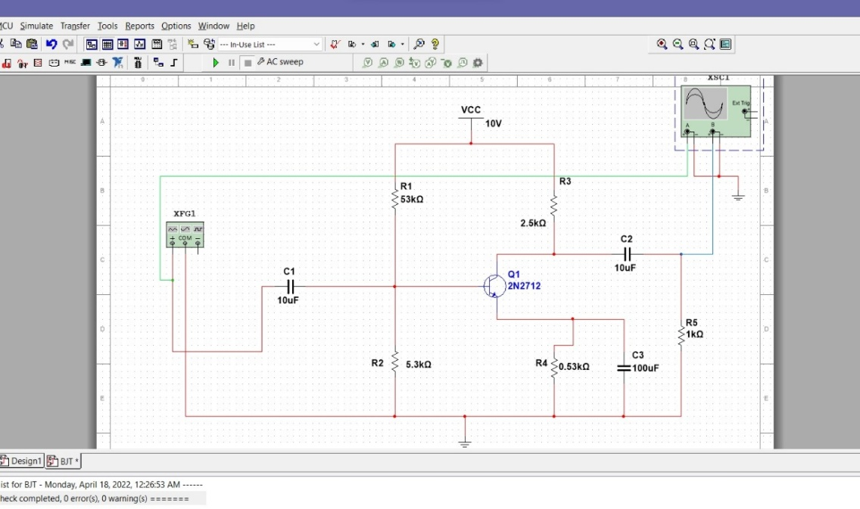
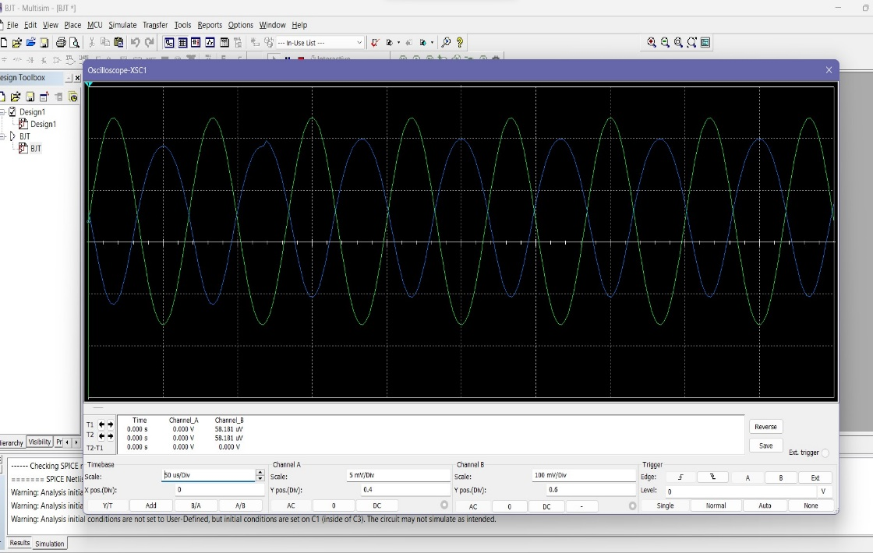
procedure
For Common emitter BJT :

Slide 7
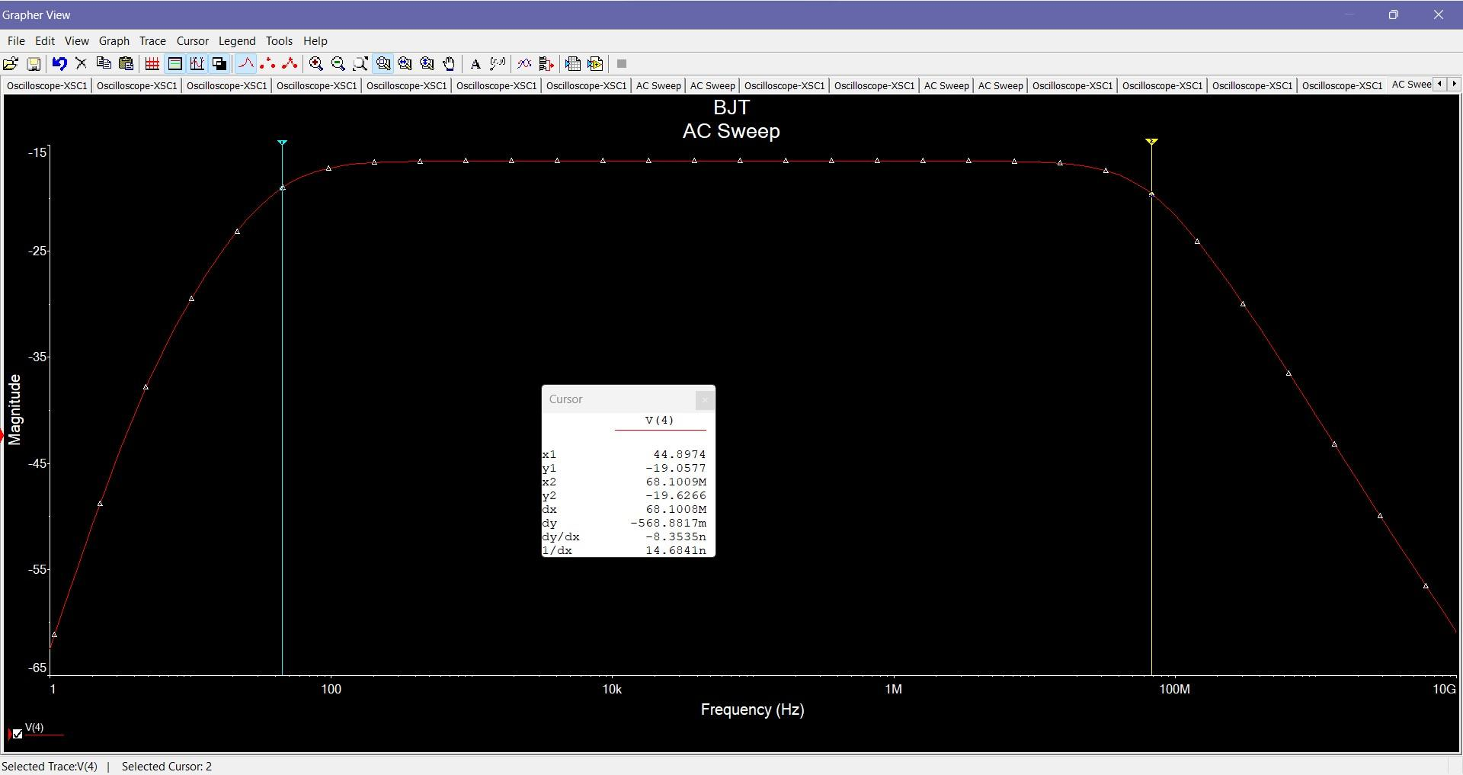
procedure

Slide 8
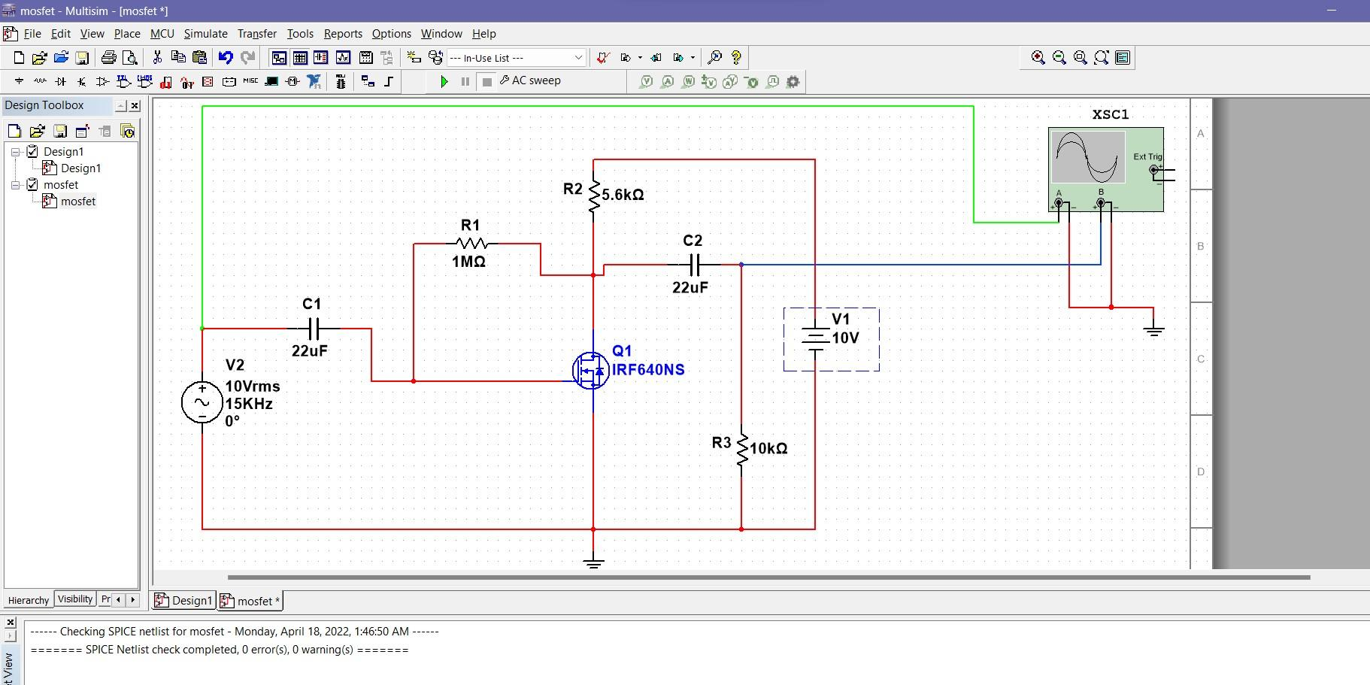
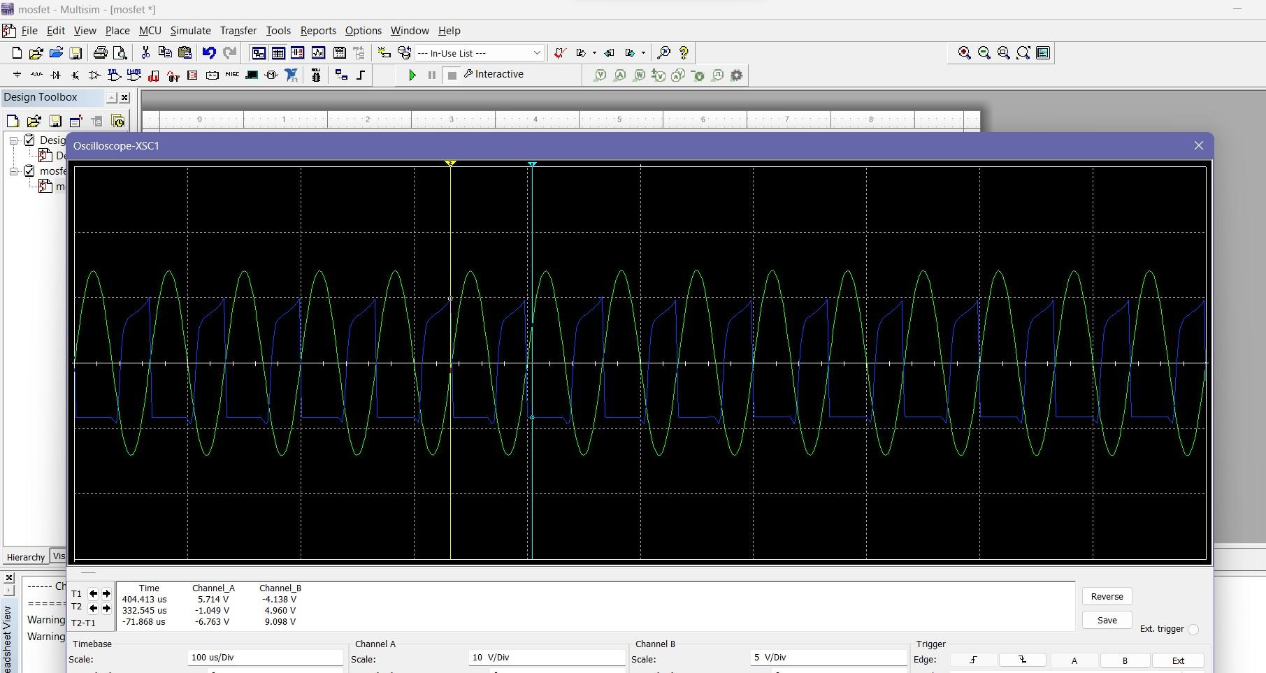
procedure
For common source MOSFET amplifier:

Slide 9
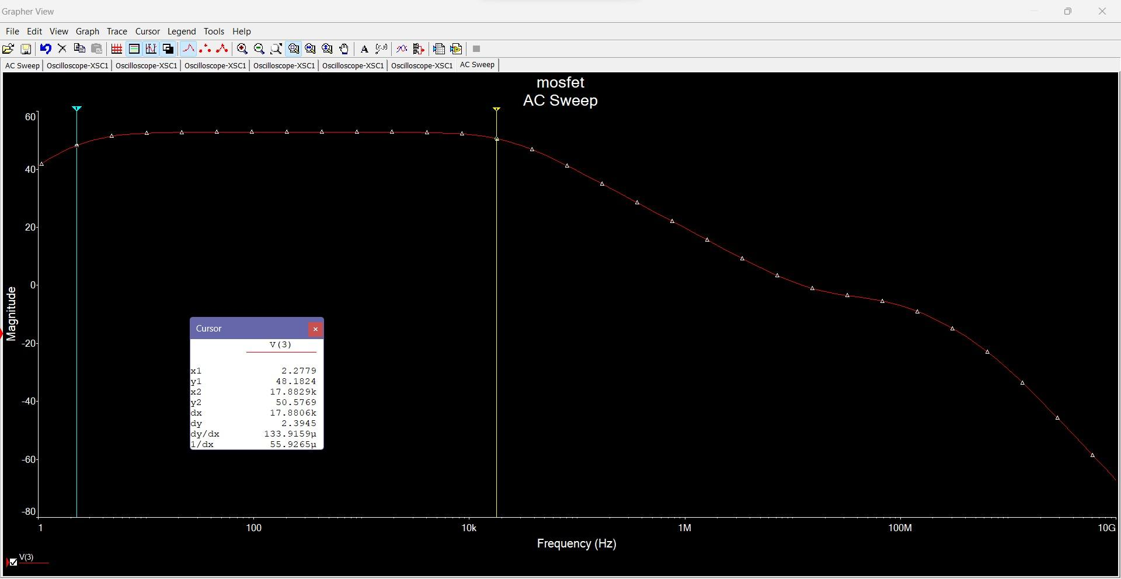
procedure
For common source MOSFET amplifier:

Slide 10
Data analysis
Serial No. | Frequency | Input Voltage, Vin | Output Voltage, Vo | Voltage Gain, (Vo/Vin) | Voltage Gain in dB, Av = 20 log(Vo/Vin)
1 | 1khz | 10mv | 295.808mv | 29.5808 | 29.42
2 | 5khz | 10mv | 302.480mv | 30.248 | 29.61
3 | 10khz | 10mv | 303.770mv | 30.377 | 29.65
4 | 15khz | 10mv | 304.912mv | 30.49 | 29.68

Slide 11
Data analysis
Serial No. | Frequency | Input Voltage, Vin | Output Voltage, Vo | Voltage Gain, (Vo/Vin) | Voltage Gain in dB, Av = 20 log(Vo/Vin)
1 | 1 KHZ | 10 V | 7.952 V | 0.7952 | -1.9904
2 | 5 KHZ | 10V | 8.296 V | 0.8296 | -1.6226
3 | 10 KHZ | 10V | 8.801 V | 0.8801 | -1.1093
4 | 15 KHZ | 10 V | 9.098 V | 0.9098 | -0.82108
Data table

Slide 12
Data analysis

Slide 13
conclusion

